Slide 1


Solving 8-Queens Problem using ROBDD
Presented To,
Dr. Hafiz Md. Hasan Babu
(Professor)Department of Computer Science and Engineering
Presented By,
Sabbir Mahmud Afridi
Roll: SH-2334
Course Name: Decision Diagrams for VLSI Design
Course Code: CSE-532
Masters Spring Semester 2024

Slide 2
Content
Introduction to 8-Queens Problem
Introduction to ROBDD
Methods for solving 8-Queens Problem
ROBDD Solution to 8-Queens Problem
Complexity Comparison
References

Slide 3
Queen
According to the rules of chess, the queen may move any number of unoccupied squares in any direction -- horizontally, vertically, or diagonally, giving her the greatest range of legal moves in the game.

Slide 4
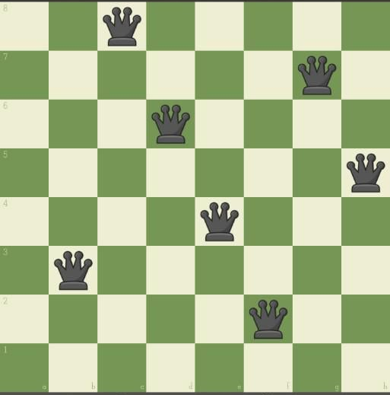
8-Queen Puzzle Problem
The n queens problem is the problem of placing n queens on an n*n chessboard such that none of them attack one another (no two are in the same row, column, or diagonal).
In 8-Queen Puzzle Problem
chessboard of (8,8) dimension size
8 queens
We have to
Place all the 8 queens in the given chessboard
No two Queens can kill or attack each other

Slide 5
Introduction to ROBDD Reduced ordered binary decision Diagram
ROBDD is a data structure for representing Boolean functions in a compact and efficient way.
A BDT is reduced if:
Any two identical nodes is merged into one.
No node ‘u’ exists such that low value (u) = high value (u) [Node Elimination]
Removing duplicate Terminal Nodes

Slide 6
ROBDD Example Ordered BDT

Slide 7
ROBDD Example Ordered BDD (Removing Terminal Nodes)

Slide 8
ROBDD Example Ordered BDD (Removing Redundant TeSTS)

Slide 9
ROBDD Example ROBDD

Slide 10
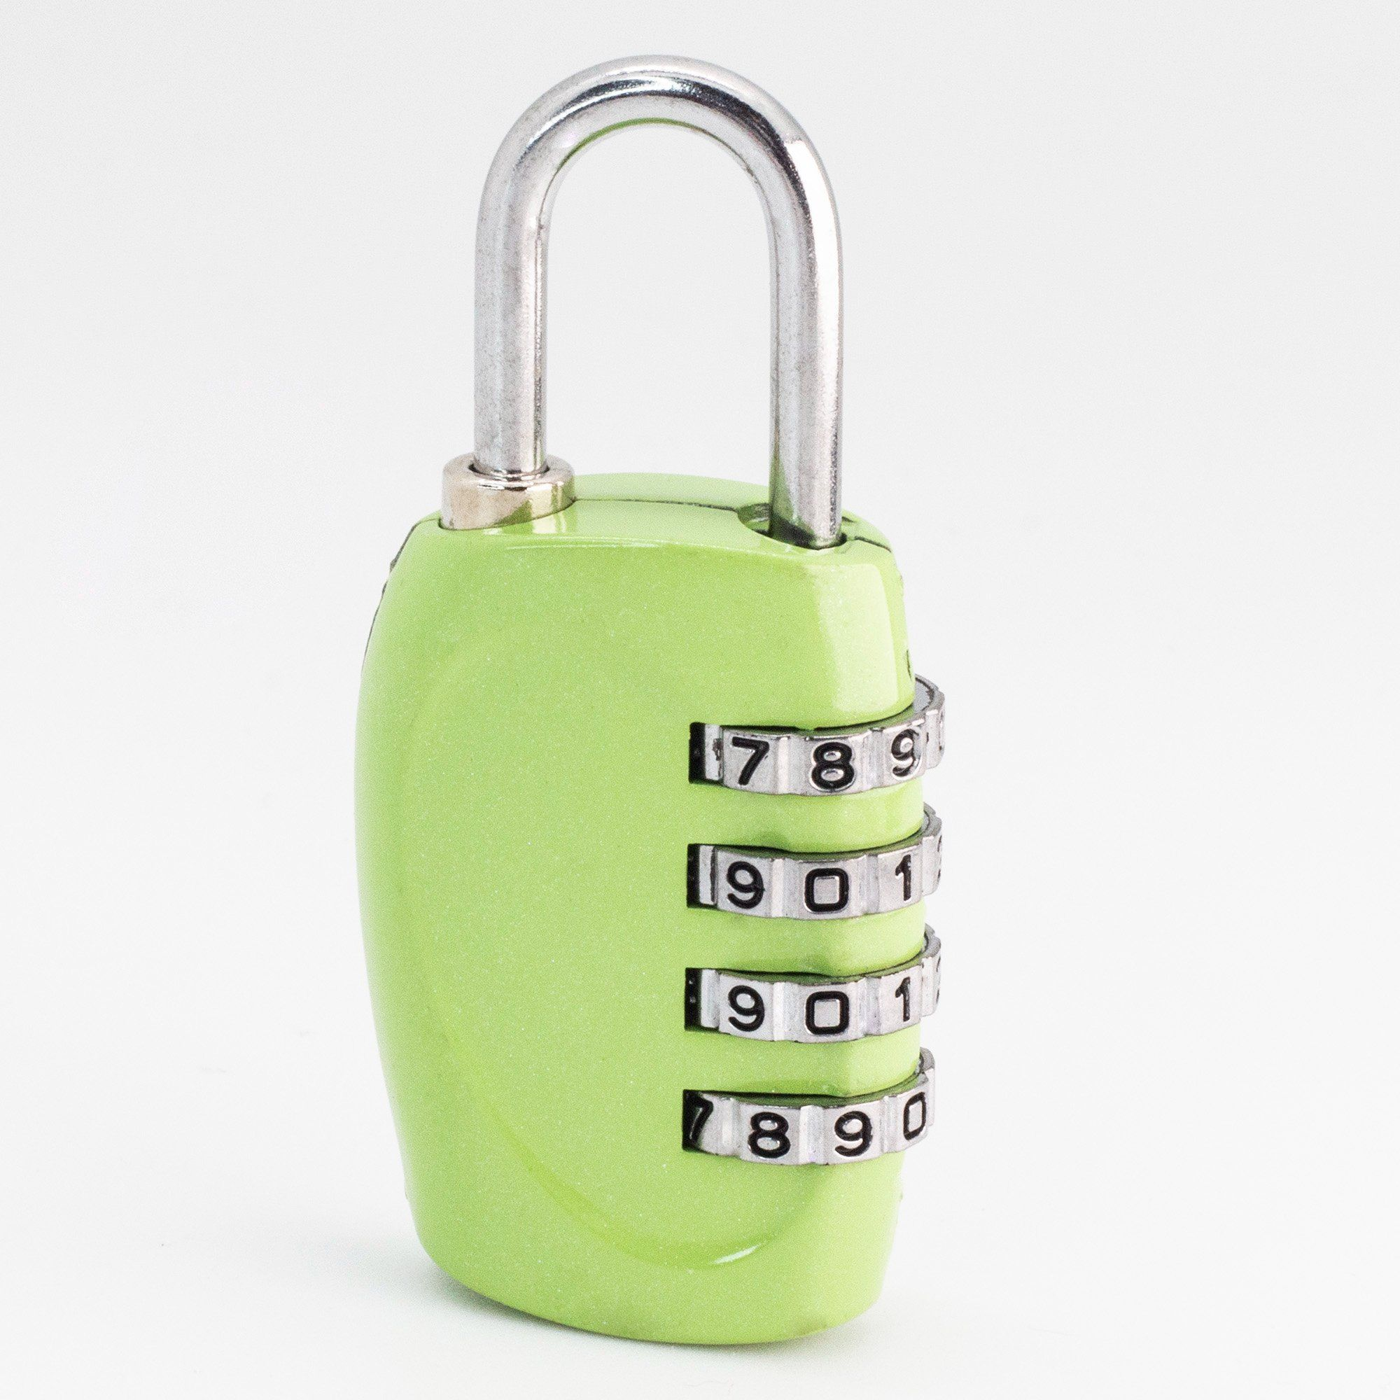
Methods for solving 8-Queens Problem Method 1: Brute Force Approach
0 0 0
0 0 1
…
…
9 9 8
9 9 9
(Tries Every Possible Combination)
A Straightforward Approach
Tries Every Possibilities
Does not consider Advance Techniques

Slide 11
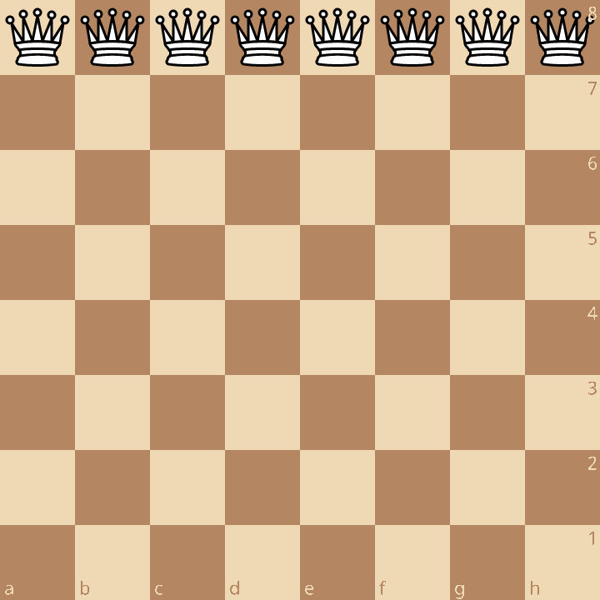
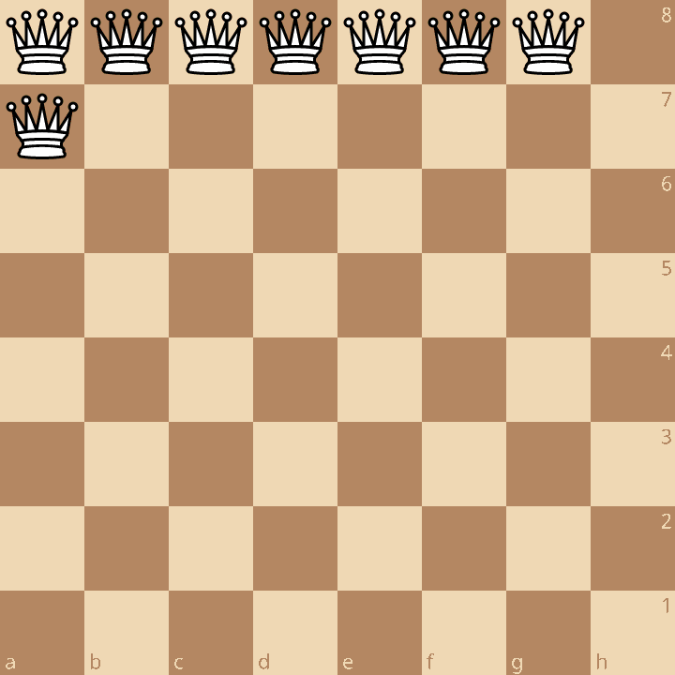
Methods for solving 8-Queens Problem Method 1: Brute Force Approach (contd.)
1st Combination
2nd Combination

Slide 12
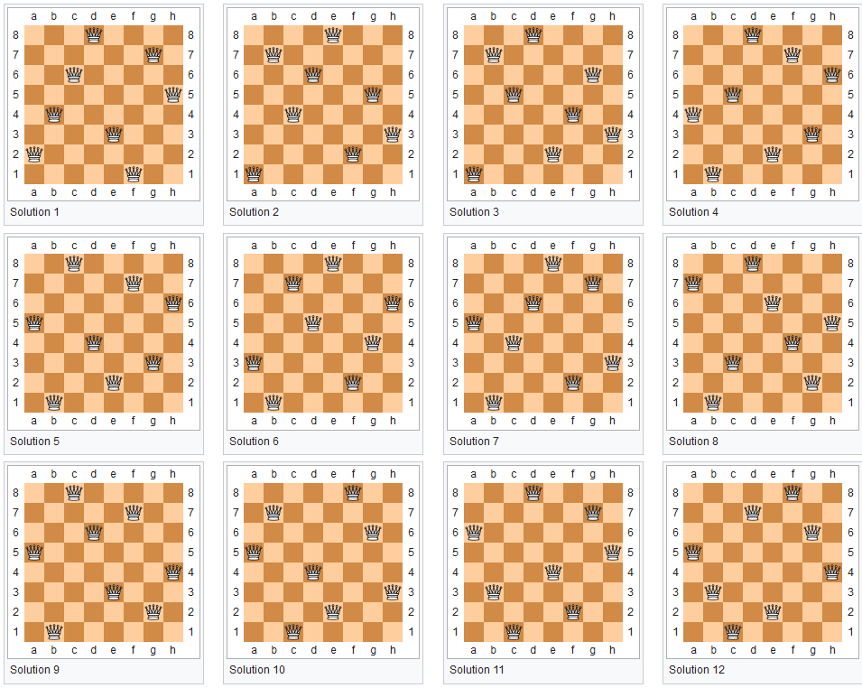
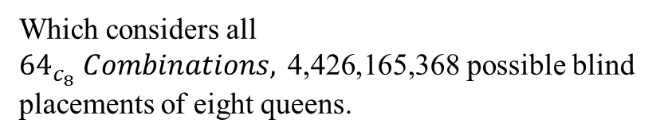
Methods for solving 8-Queens Problem Method 1: Brute Force Approach (contd.)
Which considers all
${64}_{c_{8}} Combinations, \text{4,426,165,368}$possible blind placements of eight queens.

Slide 13
Methods for solving 8-Queens Problem Method 2: BackTracking
Start with an empty chessboard and place a queen in the first row.
Move to the next row and try placing a queen in each column.
Check for safety at each position (no queens in the same column or diagonal).
Backtrack if stuck by removing the previous queen and trying the next column.
Repeat until all 8 queens are placed, then record the solution and explore other possibilities if needed.

Slide 14
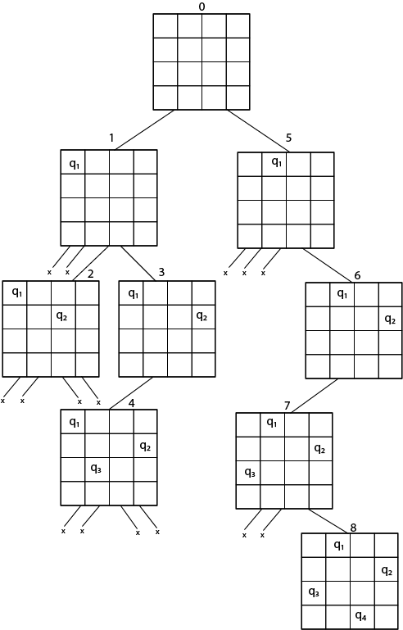
Methods for solving 8-Queens Problem Method 2: BackTracking (Cont.)

Slide 15
ROBDD Solution of N-Queens Problem
Step 1: Define the N-Queen problem in the form of boolean expression.
Step 2: Using the boolean expression to get to ROBDD solution.

Slide 16
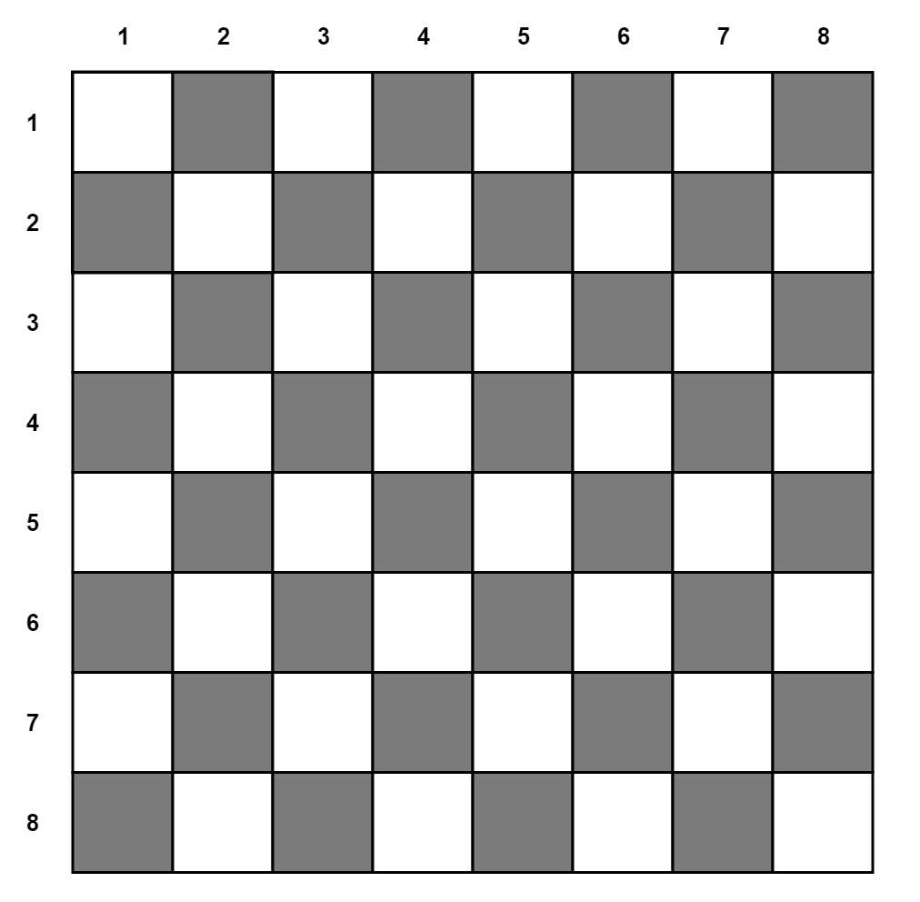
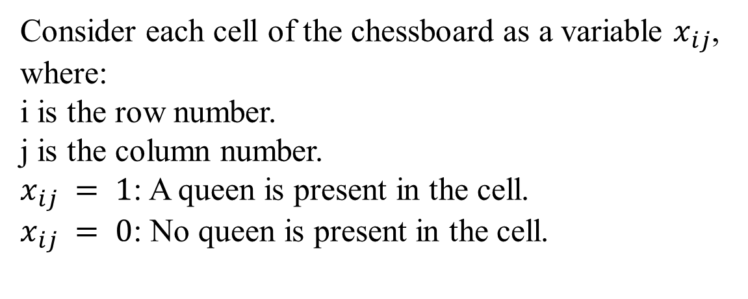
ROBDD Solution of N-Queens Problem
Consider each cell of the chessboard as a variable $x_{ij}$,​
where:
i is the row number.
j is the column number.
$x_{ij} = 1$: A queen is present in the cell.
$x_{ij} = 0$: No queen is present in the cell.

Slide 17
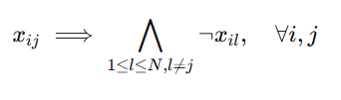
ROBDD Solution of N-Queens Problem
Requirement 1: No Two Queens in the Same Row.

Slide 18

ROBDD Solution of N-Queens Problem
Requirement 2: No Two Queens in the Same Column.

Slide 19
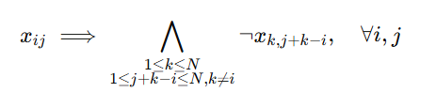
ROBDD Solution of N-Queens Problem
Requirement 3: No Two Queens in the Same Right Diagonal.

Slide 20
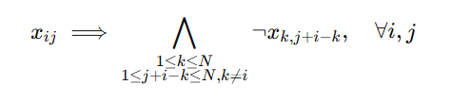
ROBDD Solution of N-Queens Problem
Requirement 4: No Two Queens in the Same Left Diagonal.

Slide 21
ROBDD Solution of N-Queens Problem
These 4 requirements together are not enough to ensure solution.
❏ A chessboard with no Queens placed can satisfy the 4 requirements.
❏ But cannot be a valid solution for the N-Queens problem.

Slide 22
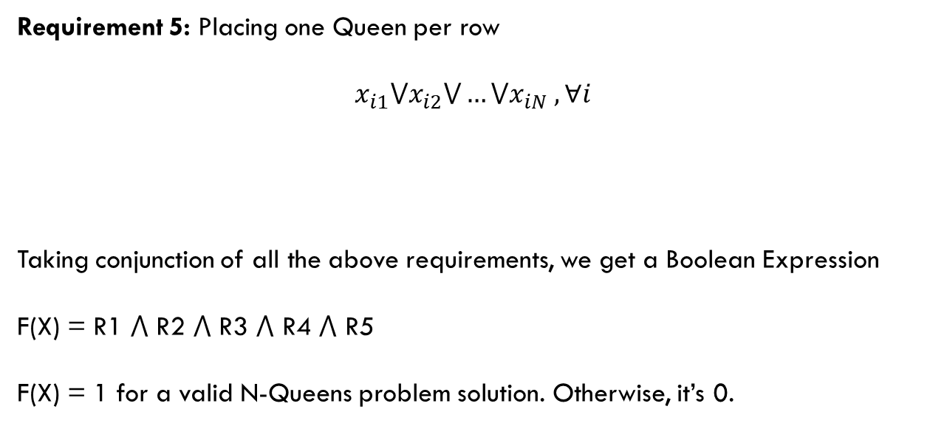
ROBDD Solution of N-Queens Problem
Requirement 5: Placing one Queen per row
$x_{i1}{⋁x}_{i2}⋁…⋁x_{iN} , ∀i$
Taking conjunction of all the above requirements, we get a Boolean Expression
F(X) = R1 ⋀ R2 ⋀ R3 ⋀ R4 ⋀ R5
F(X) = 1 for a valid N-Queens problem solution. Otherwise, it’s 0.

Slide 23
ROBDD Solution of N-Queens Problem
Requirement 5: Placing one Queen per row
$x_{i1}{⋁x}_{i2}⋁…⋁x_{iN} , ∀i$
Taking conjunction of all the above requirements, we get a Boolean Expression
F(X) = R1 ⋀ R2 ⋀ R3 ⋀ R4 ⋀ R5
F(X) = 1 for a valid N-Queens problem solution. Otherwise, it’s 0.

Slide 24
ROBDD Solution Designing BDD
Design a BDD
Traverse through all the path in the BDD
The path in the BDD satisfying F(X) is pointed to the leaf node 1.
The path which does not is pointed to the leaf node 0.
Finally ensuring the ROBDD solution, by converting the BDD to ROBDD using the reduction rules.

Slide 25
ROBDD Solution Designing BDD

Slide 26
ROBDD Solution Results
The 8-Queens problem has 92 distinct solutions! But 12 representative solutions.
Figure: All 12 8-Queens representative solutions

Slide 27
Complexity Comparison
Bruteforce Method | O(N^(2N))
Backtracking Method | O(N!)
Using ROBDD | 2^m (Where m = n ✕ n)
O(n^(2n)) is greater than both n! and 2^m. Bruteforce Approach is the slowest.
n! eventually grows faster than an exponential with a constant base (e.g 2m or em)
So, ROBDD Approach eventually will become faster compared to the Backtracking Approach!!

Slide 28
References
Md, Hafiz & Nonmember, Hasan & Sasao, Tsutomu. (2000). Representations of Multiple-Output Functions Using Binary Decision Diagrams for Characteristic Functions.
H. Moeinzadeh, M. Mohammadi, H. Pazhoumand-dar, A. Mehrbakhsh, N. Kheibar and N. Mozayani, "Evolutionary-Reduced Ordered Binary Decision Diagram," 2009 Third Asia International Conference on Modelling & Simulation, Bundang, Indonesia, 2009, pp. 142-145, doi: 10.1109/AMS.2009.130.
Saamiberk. (n.d.). GitHub - saamiberk/Eight-Queens-Problem-using-Hill-Climbing-GUI: Solving and GUI demonstration of Eight-Queens Problem using Hill Climbing. GitHub. https://github.com/saamiberk/Eight-Queens-Problem-using-Hill-Climbing-GUI
GeeksforGeeks. (2023, March 8). 8 queen problem. GeeksforGeeks. https://www.geeksforgeeks.org/8-queen-problem/
Lecture 07-2 Reduced ordered binary decision diagram (ROBDD) [Video]. YouTube. https://www.youtube.com/watch?v=jLrAeSXoTaE

Slide 29
Thank You

